Slide 1
Enhanced Medical Management Reporting for Health Care Clients
January 1, 2021

Slide 2
Enhanced Medical Management reporting
Specialized reporting for health care clients that supports Population Health Management
The four value-added reports are:
Medical Management Report
Sold as a report bundle (Report Package A)
Patient Profile Report
Risk Score Report
Sold as a report bundle—strategy for year two (Report Package B)
Gaps-in-Care Report
Notes:
The Enhanced Medical Management Reporting Package A and B are optional products for hospitals, medical centers and other large health care provider clients.
These are carrier-level ACO reports that can be used to monitor the health of the population. Additional details on the next slides.

Slide 3
Daily Medical Management report
What is it?
Daily report that scans utilization review records to identify members have been—or will be—hospitalized, or have been precertified for future services, both of which may indicate an opportunity for Care Management intervention and engagement.
Use
Identifies members for timely outreach by the PCP, for re-engagement attempts
Identify members who declined Care Management, but need it
Identifies practices with large volume of precertifications, but low Care Management enrollment
Identifies invalid member contact information
Value
First alert of potential member health issues
Lower total cost of care by getting members engaged in Care Management

Slide 4
Daily Medical Management report: Samples
Click Browse button and locate your daily MMR file: |  | At any time, to remove any filter applied: |  | To format the report: |  | To unformat the report:
Browse
Un filter
Format
Unformat
Step 2: Select Macro (button) for the patient listing desired
Inpatient |  | To identify patients currently “Inpatient” in the Report: |  | To identify patients currently “Inpatient” on the Report and all SOEs for that patient: |  | To identify patients “Recently Discharged” and all SOEs for that patient:
UTR |  | To identify “Unable to Reach” patients in the Report: |  | To identify “Unable to Reach” patients that are New UTR: |  | To identify patients currently in a Disease Management Program and UTR: |  | To identify patients currently in a CM Program and UTR: |  | To identify patients currently in a Maternity Management Program and UTR:
Decline |  | To identify “Decline” patients in the Report: |  | To identify patients currently in a Disease Management Program and Decline: |  | To identify patients currently in a CM Program and Decline: |  | To identify patients currently in a Maternity Management Program and Decline:
Inpatient
All SOEs for Active Inpatients
All SOEs for Recently Discharged
All Unable to Reach
New UTR Cases
Disease Management & UTR Cases
CM & UTR Cases
Maternity Management & UTR Cases
All Decline
Disease Management & Decline Cases
CM & Decline Cases
Maternity Management & Decline Cases
Report includes a macro-driven front-end in Excel, which allows a simple point-and-click interface to retrieve key information.

Slide 5
Daily Medical Management report: Samples
Last Name | First Name | Provider Name | Product | Status Reason | Principle Diagnosis Code | Principle Diagnosis Description
DOE | JANE | JONES, SALLY | UR | DECLINED | C92.92 | MYELOID LEUKEMIA
SMITH | BARBARA | SMART, BILL | UR | UNABLE TO CONTACT | F33.1 | MAJOR DEPRESSIVE DISORDER
You will have the opportunity to intervene and encourage participation in Care Management on a daily basis.

Slide 6
Patient Profile report
What is it?
Provides a snapshot of members with chronic health conditions, their participation level in Care Management, plus a summary of medical and Rx claims spend, including ER visits.
Use
Identify members with chronic conditions
Drive more desirable behaviors, like PCP visits over ER visits
Encourages collaborative discussions between the PCP and the member
Improves communications
Value
Encourages members to engage in an appropriate level of care
Encourages the use of Care Management programs
Lowers total cost of care for the plan by focusing on the high cost associated with chronic conditions

Slide 7
Patient Profile report: Samples
The patient profile report will help you drive down plan cost by focusing on members with chronic conditions. This will help you review care plans, claims spend, and utilization patterns
Last Name | First Name | High Risk High Cost | ERG Pro Risk Score | Total IP Paid Amt | Total Prof Paid Amt | ED Visits 12 Months | Diagnosis 1 | DM Status | DM Status Reason
DOE | JOHN | Y | 6+ | $ 8,036 | $ 3,367 | 2 | J45.5 ASTHMA SEVERE | CLOSED | UNABLE TO CONTACT
JONES | SALLY | Y | 6+ | $ 7,456 | $ 4,390 | 2 | G8922 CHRONIC PAIN | CLOSED | DECLINED

Slide 8
Risk Score report
What is it?
A monthly member-level health and cost risk score
Use
Highlights members who may be at risk for a high intensity/ catastrophic event
Enables monitoring of population risk and cost trends
Identifies members who may need Care Management that may not have been identified through precertification or other referral mechanisms
Value
Risk scores are provided on all members, not just those that have a precertification, or have case or disease management
Monitoring and addressing high risk members will help lower total cost of care for the plan
What metrics does it include?
Retrospective risk score
Prospective risk score
Average # of members
# claimants | # of high-cost claimants
Episodes/1000
Allowed PMPM
What dimensions are available?
By Episode Treatment Group (ETG)
By Member
By Age Band
By Gender
By Major Condition

Slide 9
Risk Score report—Aggregate level: Sample
ETG Base | Claimants | Episodes | Claimants/1000 | Paid/Claimant | Prospective Risk | Retrospective Risk
164800 Obesity | 2,755 | 2,755 | 130.9 | $321.79 | 1.85 | 2.16
388100 Hypertension | 4,142 | 4,142 | 196.8 | $391.18 | 2.11 | 2.39
439300 COPD | 128 | 128 | 6.1 | $3,086.58 | 3.65 | 4.63
Help keep plan costs down by addressing the needs of members who are at risk for high intensity events.

Slide 10
Risk Score report—Member level: Sample
Encrypted Member ID | Leading Diagnostics MCC | Paid | Episodes | IP Admits | OP Visits | PR Services | Rx Scripts | OP Emergency Room Visits | Prospective Risk | Retrospective Risk
0000000000 | Renal/Urinary tract: kidney failure | $253,639 | 9 |  | 287 | 64 | 136 |  | 13.20 | 12.23
0000000000 | Musculoskeletal: Rheumatoid Arthritis | $32,473 | 1 |  |  | 54 | 25 |  | 10.01 | 9.39
Risk score also provides a member level report for easy identification and intervention.

Slide 11
Gaps-in-Care report
What is it?
A monthly report that reviews and compares treatment patterns against evidence-based guidelines.
Use
The Gaps-in-Care report allows users to review treatment pattern compliance gaps for the entire population, as well as the identification of specific members.
Value
Care delivery, and ultimately plan cost, can be reduced by evaluating activity against the full list of benchmarks
What metrics does it include?
Compliance rate
Compliance rate benchmark
# of Gaps
# of Compliant and Non-Compliant members
What dimensions are available?
By Episode Treatment Group (ETG)
By Member
By Guideline Gap
By State

Slide 12
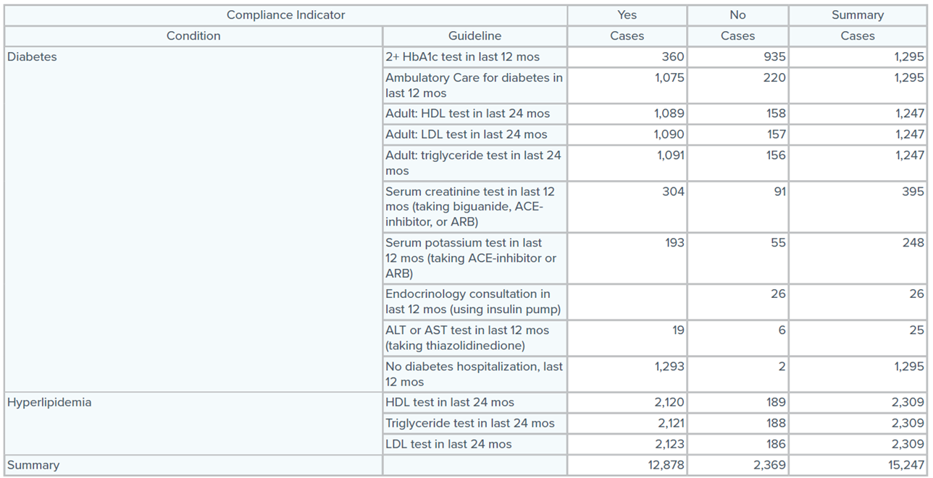
Gaps-in-Care report—Aggregate level: Sample
Aggregate and member-level data is provided, which will help you see where improvements can be made.

Slide 13
Appendix
Report comparison
Notes:
ATLAS reporting and benchmarking

Slide 14
Report comparison—reports for health care clients
Report Feature | iSuite Activity Reports¹ | Clinical Case Management Reports | AHH Summary Reports (UM, CM, DM, MNB) | Medical Mgmt. Report | Patient Profile Report | Risk Score Report | Gaps-in-Care Report
Report Frequency
Near-Real Time Data (On Demand) | ✓
Daily |  |  |  | ✓
Monthly |  |  | ✓ |  | ✓ | ✓ | ✓
Quarterly |  |  | ✓
Every 30, 60 or 90 days |  | ✓
Report Grouping
List (Detailed Level; List by Case or Member) | ✓ |  |  | ✓ | ✓ | ✓ | ✓
By Single Case |  | ✓
Summary (Aggregate Level; YTD) |  |  | ✓ |  |  | ✓ | ✓
Report Content
Case Details | ✓ | ✓
Clinical History and Case Prognosis |  | ✓
Medical Management Savings |  | ✓ | ✓
Activity Summary |  |  | ✓
Referral Summary |  |  | ✓
Diagnostic Summary |  |  | ✓
Demographic Summary |  |  | ✓
Program Participation Summary |  |  | ✓
Program Outcomes Summary |  |  | ✓
Admits/1000, Days/1000, ALOS Benchmark Summary |  |  | ✓
Program Savings Summary |  |  | ✓
Member Contact Information |  |  |  | ✓ | ✓
Med. Mgmt. Program X-Ref. Activity (IP, OP, CM, DM, Mat.) |  |  |  | ✓ | ✓
Member Risk Score |  |  |  | ✓ | ✓ | ✓
Total Paid Medical Claims $, Rx $ (Aggregate Claims Spend) |  |  |  |  | ✓
# of Emergency Department Visits (Aggregate Count) |  |  |  |  | ✓
Chronic Disease Indicators |  |  |  |  | ✓
Gaps-in-Care Indicators (Selected) |  |  |  |  | ✓
Episode Treatment Groups (ETGs) |  |  |  |  |  | ✓
Retrospective / Prospective Risk Scores (ERGs) |  |  |  |  |  | ✓
Risk Tier (H, M, L) |  |  |  |  |  | ✓
HEDIS-based Compliance Gaps Detail by Multiple Dimensions |  |  |  |  |  |  | ✓
¹Includes the following:
UM Cert Activity
UM Daily Patient Activity
UM - CM Referral List
UM Discharge Activity
UM Extended Length of Stay
UM In-Patient Facility List
Maternity – High Risk Case List
CM - Open Case Listing

Slide 15
PROPRIETARY NOTICE
IMPORTANT CONFIDENTIALITY NOTICE - PLEASE READ! This Confidential Information, provided by Meritain Health, is intended only for the use of the addressee and only for the purpose that it is being provided. The Confidential information shall not be distributed, disclosed or conveyed to any consultant, subcontractor, vendor or other third party. The addressee is required to use appropriate safeguards to protect the Confidential information from unauthorized disclosure. If you are not the intended recipient, you are hereby notified that any disclosure, copying, distribution, or action taken in reliance on the contents of these documents is strictly prohibited. If you have received these documents in error, please notify the Meritain Health Privacy Officer immediately to arrange for their return at 800.831.1166.
© 2021–2022 Meritain Health, Inc.
www.meritain.com

