Slide 1
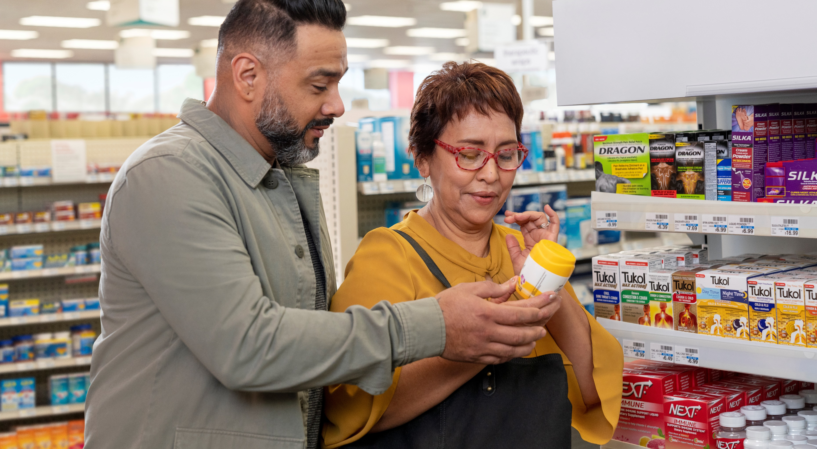
Over-the-Counter (OTC) Health Solutions
1 | Meritain Health

Slide 2
CVS OTC Health Solutions
Program Benefits
Additional value to your employees by impacting their health and wellness journeys.
Cost effective - Reduces medical costs.
Convenient - 70% of people in the U.S. live within three miles of a CVS Health location. Or order online or over-the-phone.

Slide 3
The expansion of OTC affordability benefits consumers and businesses alike.¹ The Consumer Healthcare Products Association found that
Every $1 spent on OTC medicines can save more than $7
for the US health care system.²
FSA/HSA Info Sheet and FAQs [news release]. GlaxoSmithKline. Accessed July 20, 2023.
Consumer Healthcare Products Association. White Paper: Value of OTC Medicines to the U.S. Healthcare System. Consumer Healthcare Products Association website. overthecountervalue.org/white-paper/. Published March 2019. Accessed July 20, 2023
3 | Meritain Health

Slide 4
What is OTCHS?
Learn more about the CVS Pharmacy program that provides OTC supplemental benefit fulfillment.
Employees enrolled in a Meritain Health medical plan will receive $25 quarterly* allowance to use on eligible OTC products.
* Allowance given quarterly: January 1–March 31; April 1–June 30; July 1–September 30; October 1–December 31. The allowance given does not roll over each quarter.
Click the button on the monitor to play the OTC Health Solutions Overview video.
4 | Meritain Health

Slide 5
Member Awareness Resources
5 | Meritain Health

Slide 6
Drive registration and utilization of the OTC Health Solutions program
Resources include:
2024 OTC Item Catalog - Includes ordering instructions, all eligible items and a FAQ. Members can find it by heading to the OTCHS registration portal. The catalog is available in English & Spanish.
OTC Employee Flyer – Provides highlights of the program.
OTC Welcome Letter – Introduces specific allowance and OTC contact information.
OTC Email Series - Provides overview of the program and reminds members to use their allowance suggested quarterly use.
6 | Meritain Health

Slide 7
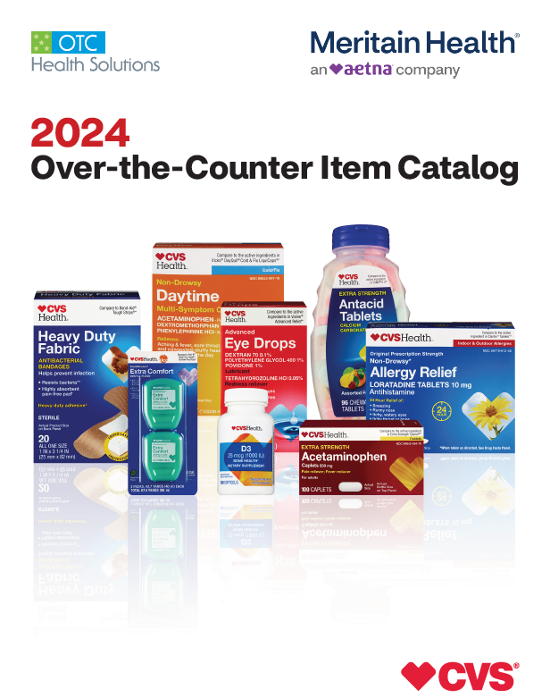
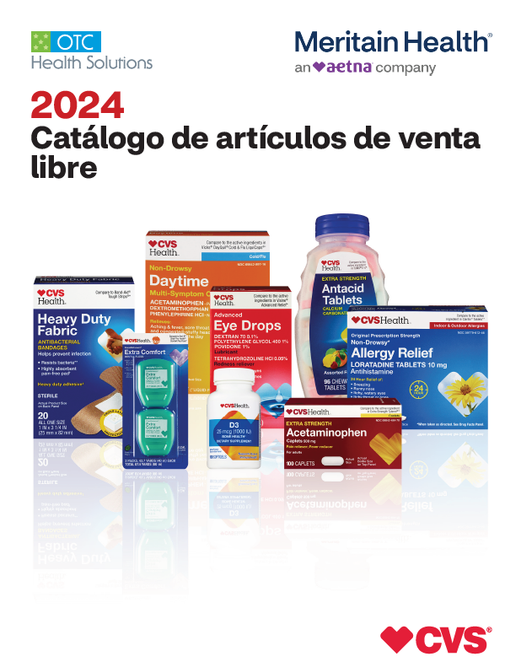
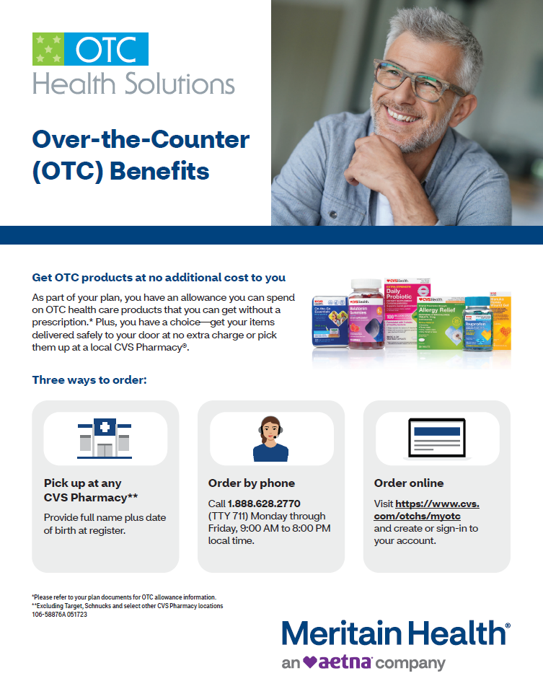
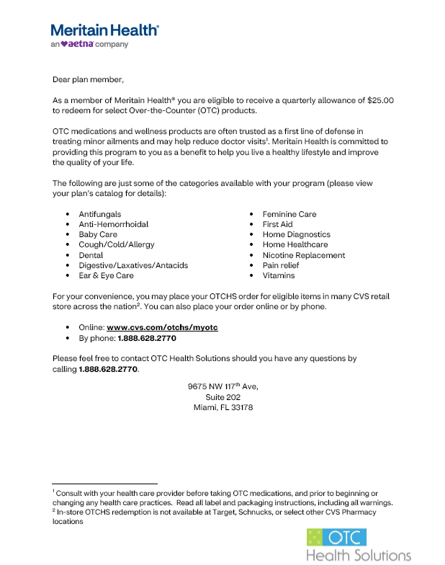
Creating Awareness
Materials a plan sponsor can share with their employees. Click the image to open the .pdf document.
2024 OTC Item Catalog (available in English and Spanish)
OTC Employee Flyer
OTC Employee Welcome Letter

Slide 8
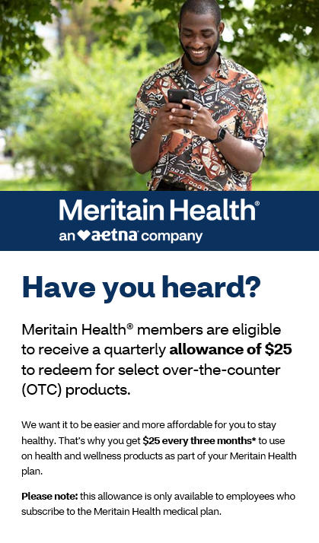
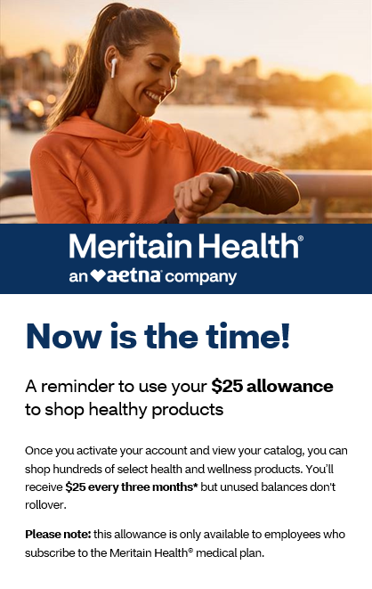
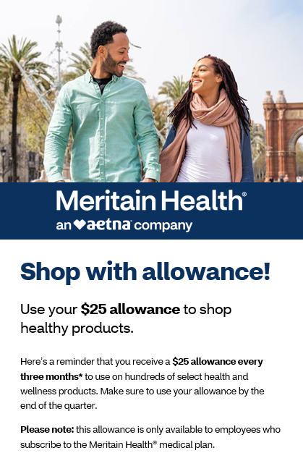
Creating Awareness
Email series a plan sponsor can send to their employees to remind them of this program. Double click the email icon to open the template.

